Slide 1
Project Planning and Scheduling

Slide 2
Project planning
Planning crucial to achieving goals:
The main purpose of project planning is to guide project execution
It is easy to become sidetracked if there are no good plans to follow.
People more likely to perform well if they know what they are supposed to do and when
Plans must be realistic and useful, so a fair amount of effort must go into the project planning process.

Slide 3
Project planning
The PMBOK® Guide, Fifth Edition lists over 50 documents project teams can produce as part of project planning
Figure 1 (in next slide) summarizes the project planning processes and outputs for integration, scope, time, and cost management listed in the PMBOK® Guide, Fifth Edition.
However, every project is unique, so project managers and their teams must determine which planning outputs are needed for their projects and how they should be created.

Slide 4
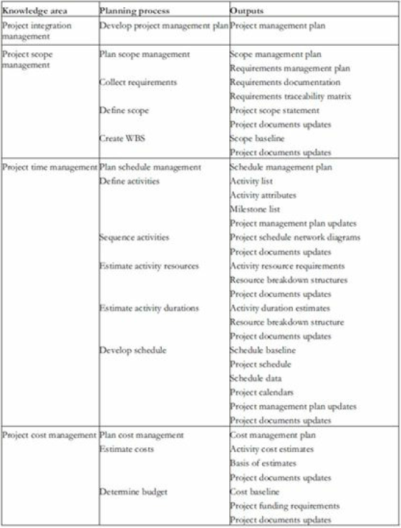

Slide 5
PROJECT INTEGRATION MANAGEMENT
Involves coordinating all the project management knowledge areas throughout a project’s life span.
Output is project management plans, which briefly describes the overall scope, time, and cost baselines for the project - assist the project manager in leading the project team and assessing project status
The plans should be dynamic, flexible, and receptive to change when the environment or project changes.
Common elements to most project management plans:
Introduction/overview of the project
Project organization
Management and technical processes
Work to be performed
Schedule information
Budget information
References to other project planning documents

Slide 6
PROJECT SCOPE MANAGEMENT
Involves defining and controlling what work is or is not included in a project.
Main planning processes performed as part of project scope management include planning scope management, collecting requirements, defining scope, and creating the WBS
For example, contents of the scope management plan include:
preparing a detailed project scope statement
creating, maintaining, and approving the WBS
obtaining acceptance of the completed project deliverables
controlling how requests for changes to the project scope statement will be processed

Slide 7
Creating a work breakdown structure (WBS)
A WBS is a document that breaks all the work required for the project into discrete activities, and groups those activities into a logical hierarchy
The lowest level of a WBS is called a work package or task, and each should be defined at an appropriate level of detail to estimate what it would cost and how long it would take to create.
Defining task in too much detail will make the management of the project unnecessarily complex
Tasks having too much scope will not provide a clear sense of the state of the project or the dependencies between the tasks.
Discovering the optimal level of detail is acquired through experience.

Slide 8
Creating a work breakdown structure (WBS)
Some tasks may be performed in parallel while others must follow one another sequentially. Task sequence depends on:
Which tasks produce deliverables needed in other tasks
Constraints placed on the project by the client
Process outlined in the development life cycle
A WBS is often depicted in a graphical format, similar to an organizational chart. The name of the entire project is the top box, called level 1, and the main groupings for the work are listed in the second tier of boxes, called level 2.
Each of those boxes can be broken down or decomposed into subsequent tiers of boxes to show the hierarchy of the work.
A WBS can also be shown in tabular form as an indented list of tasks.

Slide 9
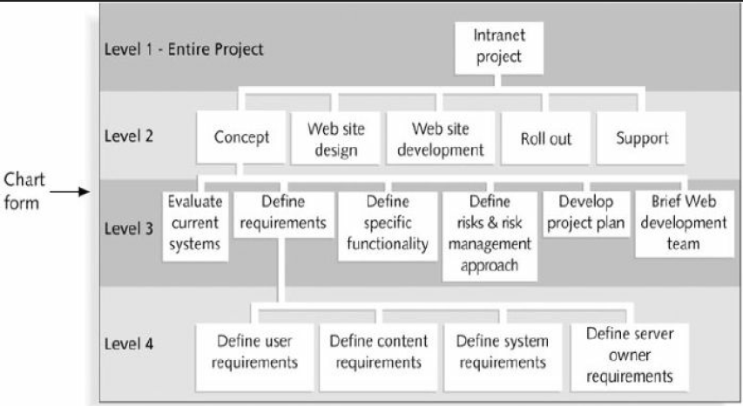
Sample WBS – in chart form

Slide 10
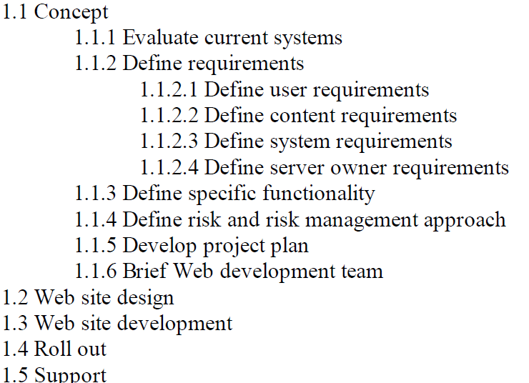
Sample WBS – in tabular form

Slide 11
Approaches to Developing Work Breakdown Structures
Using guidelines - Most of the time the organization or company you are developing the project for will have their own guidelines for developing the WBS.
The analogy approach - uses a WBS from a similar past project as a starting point for developing the WBS
The top-down approach - takes the large items of the project and decomposes them into their subordinate items
The bottom-up approach - Team members define as many tasks related to the project as possible. These tasks are then aggregated, and organized in summary level tasks or higher level tasks on the WBS.
The mind-mapping approach - allows members of the project team, to record their ideas in a non linear fashion when developing the WBS - is more of a visual documentation technique.

Slide 12
Guidelines for Defining a Task
A task should:
  Be done by one person or a well defined group.
  Have a single and identifiable deliverable.
  Have a known method of technique.
  Have a well accepted predecessor and successor steps.
  Be measurable so that percentage completed can be determined.

Slide 13
A WBS dictionary
Many of the activities listed on a WBS can be rather vague
The WBS item should be described in more detail so that everyone has the same understanding of what it involves, thus the WBS dictionary
Use common sense in deciding how much documentation is needed eg for a simple task, verbal instructions might be sufficient
Some projects might require that each WBS dictionary item describe the responsible person or organization, resource requirements, estimated costs, and other information

Slide 14
PROJECT TIME MANAGEMENT
Involves the processes required to ensure timely completion of a project.
The main planning processes performed as part of project time management are planning schedule management, defining activities, sequencing activities, estimating activity resource, estimating activity durations, and developing the project schedule.
Planning schedule management involves determining the policies, procedures, and documentation for planning, developing, managing, executing, and controlling the project schedule.
The activity definition process includes creating an activity list and their attributes, which provide schedule-related information about each activity, such as predecessors, successors, logical relationships, leads and lags, resource requirements, constraints, imposed dates, and assumptions related to the activity.
This should be in agreement with the WBS and WBS dictionary

Slide 15
Sequencing Activities
Activity sequencing involves reviewing the activity list and attributes, project scope statement, and milestone list to determine the relationships or dependencies between activities.
The main output of activity sequencing is a network / PERT diagram, which is a is a schematic display of the logical relationships among project activities.

Slide 16
Network Analysis Diagrams
Two types:
  Activity-on-Arrow (AoA) Diagrams.
  Activity-on-Node (AoN) Diagrams.

Slide 17
Activity-on-Arrow (AoA) Diagrams
The diagram represents activities by links or arrows and the nodes represents events of activities as groups of activities start or finishing.
Rules and conventions are
  A project network diagrams may have only one start node.
  Project network diagram may have only one end-node.
  A link has duration.
  Nodes have no duration. Nodes are events and are therefore instantaneous points in time. The source node is the event of the project becoming ready to start and the sink node is the event of the project becoming completed. Intermediate nodes represents 2 simultaneous events i.e.. The event of all activities leading into a node having been completed, and the event of all activities leading out of those nodes being in a position to be started.

Slide 18
Rules and Conventions for AoA
  Time moves from left to right.
  Nodes are numbered sequentially.
  A network may not contain loops.
  A network may not contain dangles.

Slide 19
Activity-on-Arrow Diagram
C
3
A
D
H
6
4
2
B
End
4
start
E
F
G
10
3
ACG = 6+3+2= 11 Weeks. BDH = 4+4+2 = 10 Weeks.
BEG = 4+3+3 = 10 Weeks. FG = 10+3 = 13 Weeks.

Slide 20
Activity-on-Node diagrams
The arrows represent the event and the node represent the activity.
The meaning of arrows and the nodes are directly opposite to that of Activity-on-Arrow diagrams.
Project Evaluation and Review Technique (PERT) and Critical Path Modeling are two popular quantitative analysis techniques that are used with the AoN diagrams.
These techniques help managers to plan, schedule, monitor and control large and complex projects.
The critical path consists of the activities that are important and their delay will affect the entire project completion time.

Slide 21
Example: AoN
Activity | Duration | Immediate predecessors
A | 2 | -
B | 3 | -
C | 2 | A
D | 4 | B
E | 4 | C
F | 2 | C
G | 4 | D,E
H | 2 | F,G

Slide 22
AoN Diagram
A 2
C 2
F 2
H 2
FINISH
Start
E 4
B 3
G 4
D 4
What is the project’s duration?

Slide 23
Estimating Activity Resources
Before you can estimate the duration for each activity, you must have a good idea of the quantity and type of resources (people, equipment, and materials) that will be assigned to each activity
Experience and expertise in similar projects necessary
Guiding questions include:
How difficult will it be to do specific activities on this project?
Is there anything unique in the project’s scope statement that will affect resources?
What is the organization’s history in doing similar activities?
Does the organization have appropriate people, equipment, and materials available for performing the work?
Are there any organizational policies that might affect the availability of resources?
Does the organization need to acquire more resources to accomplish the work?
Would it make sense to outsource some of the work?
Will outsourcing increase or decrease the amount of resources needed and when they will be available?

Slide 24
Estimating Activity Duration
For new or unique projects, providing activity time estimates is not always easy.
Without solid historical data, project managers are usually uncertain on the activity times.
For this reason, the developers of PERT employed a probability distribution based on the following time estimates:
  Optimistic time (a).
  Pessimistic time (b).
  Most-likely time (m).
  Expected activity time (t).
  variance

Slide 25
Time Estimates
Optimistic Time (a): this is the time that an activity will take if everything goes as well as possible.
Pessimistic Time (b): The time an activity would take assuming very unfavourable conditions.
Most-Likely Time (m): Most realistic time estimate to complete the activity.
Expected Time (t)= (a + 4m + b)/6

Slide 26
Example
Activity | Optimistic time (a) | Most probable Time (m) | Pessimistic Time (b) | Expected Time (t)
A | 1 | 2 | 3
B | 2 | 3 | 4
C | 1 | 2 | 3
D | 2 | 4 | 6
E | 1 | 4 | 7
F | 1 | 2 | 9
G | 3 | 4 | 11
H | 1 | 2 | 3

Slide 27
Developing the Project Schedule
Project schedule provides a basis for monitoring project progress for the time dimension of the project.
Often displayed in the form of a Gantt Chart - lists project activities and their corresponding start and finish dates in a calendar format.
Example:
  The table in the next slide represents a software project specification with estimated project activity durations, and their precedence requirements. Draw a Gantt chart for the project.
Activities on the Gantt chart should coincide with the activities on the WBS, the activity list, and the milestone list

Slide 28
Project specifications
Activity | Activity Description | Duration(weeks) | Precedents
A | Hardware selection | 6 | -
B | Software design | 4 | -
C | Install Hardware | 3 | A
D | Code and Test Software | 4 | B
E | File Take-on | 3 | B
F | Write User Manual | 10 | -
G | User Training | 3 | E,F
H | Install and Test System | 2 | C,D

Slide 29
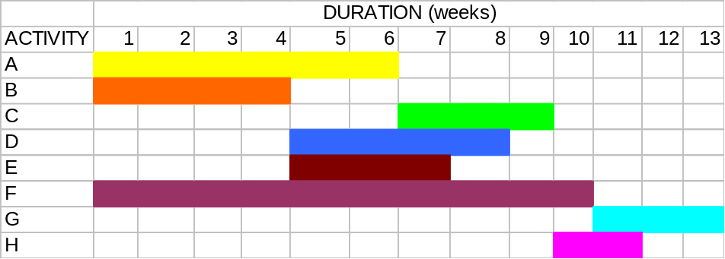
Gantt Chart for the Project
Estimated Project Duration = 13 Weeks
Note: One can use different styles, shades for the duration.

Slide 30
Finding the Critical Path
Path refers to a series of connected activities (or intermediate events) between two events in a network.
Critical path refers to the set of activities on a path from the project’s start event to its finish event, if delayed, will delay the completion date of the project.
It is the sequence of dependent tasks that have the largest sum of most likely durations – the longest path
Critical path tasks have no slack time available
Tasks that have slack time can get behind schedule by an amount less than or equal to the slack time without having an impact on the project’s final completion date
To find the critical path, the following times are calculated for each activity:
  Earliest start/event time (ES).
  Earliest Finish Time (EF).
  Latest start time (LS).
  Latest finish time (LF).

Slide 31
Calculating Earliest Activity Times: Forward Pass
Earliest Start time is the earliest time an activity can begin without violation of immediate predecessor requirements.
  ES = largest of the earliest finish times of immediate predecessors
Earliest Finish Time is the earliest time an activity can end.
  EF = Earliest start time + expected activity time
  = ES + t.
  Before any activity can begin, all of its predecessor activities must be completed I.e the largest EF for all of the immediate predecessor, used in determining ES.

Slide 32
Calculating Latest Activity Times: Backward/Reverse Pass
Latest Start Time is the latest time an activity can begin without delaying the entire project.
  LS = latest finish time – activity time
  = LF – t
  Since all immediate predecessors must be finished before an activity can begin, the latest start time for an activity determines the latest Finish time for its immediate predecessors.
Latest Finish time is the latest time an activity can end without delaying the entire project.
  LF = smallest of latest start times for following activities.

Slide 33
Notation
Activity
Duration
ES
EF
LS
LF
e. g
Design
2
0
2
2
4

Slide 34
PROJECT COST MANAGEMENT
Main planning processes performed as part of project cost management are planning cost management, estimating costs, and determining the budget
Estimating costs involves developing an approximation or estimate of the costs of the resources needed to complete a project.
Cost budgeting involves allocating the overall cost estimate to individual tasks over time to establish a baseline for measuring performance.
The main documents produced include a cost management plan, cost estimates, and a cost baseline.

